Slide 1



GE19612 - PROFESSIONAL READINESS FOR INNOVATION,
EMPLOYABILITY AND ENTREPRENEURSHIP
URCAREER: AN AI ASSISTED CAREER GUIDANCE WEB APPLICATION
BHARATHEESHWAR S (2116210701041)
GOKULA KRISHNA H (2116210701062)
PROJECT COORDINATOR:
Dr.T.Kumaragurubaran.,M.Tech.,Ph.D
Assistant Professor(SG)
DEPARTMENT OF COMPUTER
SCIENCE AND ENGINEERING

Slide 2
Abstract
The "urcareer" project aims to revolutionize career guidance and job recommendation by leveraging advanced technology. It introduces a comprehensive web application that assists individuals in finding suitable career paths and job opportunities based on their skills and experiences. Through the seamless integration of cutting-edge technologies such as natural language processing (NLP), machine learning (ML), and cloud-based APIs, "urcareer" offers an innovative solution to the challenges of traditional career counseling methods.The core functionality of the application begins with users uploading their resumes, which are then analyzed using NLP techniques to extract relevant keywords and skills. these keywords are assigned weightage based on their importance, providing a more accurate representation of the user's expertise. Subsequently, the system generates personalized assessment questions using OpenAI's language model, tailored to evaluate the user's proficiency in various domains.Upon completing the assessment, users receive detailed feedback on their performance, including scores and recommendations for further career development.

Slide 3
Problem Statement
The conventional approach to career guidance often falls short in providing tailored recommendations and personalized insights, leaving individuals feeling lost amidst the vast array of career options. Moreover, the job market is constantly evolving, making it challenging for individuals to navigate and identify suitable employment opportunities that align with their skills and aspirations. This lack of personalized guidance results in frustration, indecision, and underutilization of talent, leading to suboptimal career outcomes.Existing career counseling methods rely heavily on manual assessments and generic advice, which are time-consuming, subjective, and often outdated. Furthermore, the rapid advancements in technology and the emergence of new industries require a more dynamic and data-driven approach to career planning.There is a pressing need for a modernized career guidance system that harnesses the power of technology to offer personalized recommendations and actionable insights tailored to individual skills, interests, and career goals. Such a system should leverage advanced techniques like natural language processing (NLP) and machine learning (ML) to analyze resumes, assess skill levels, and match users with relevant job opportunities in real-time. Additionally, integrating external APIs, such as OpenAI, can enhance the system's capabilities by generating customized assessments and providing valuable feedback to users.

Slide 4
Existing System
The traditional approach to career guidance primarily involves human counselors providing advice and recommendations based on standardized assessments and subjective evaluations. In this system, individuals seeking career guidance typically schedule appointments with career counselors or utilize online platforms to access generic career advice and resources.
Manual Assessments: Career counselors often rely on manual assessments, interviews, and questionnaires to gather information about an individual's skills, interests, and career aspirations. These assessments are time-consuming, subjective, and may not always accurately reflect an individual's capabilities or preferences.
Generic Recommendations: The advice provided by career counselors is often generic and may not take into account the specific skills, experiences, or aspirations of the individual. This one-size-fits-all approach can lead to recommendations that are not aligned with the individual's career goals or potential.

Slide 5
Proposed System
The proposed solution, "urcareer", is an innovative web application that revolutionizes career guidance and job recommendation by leveraging advanced technology and data-driven insights.
Automated Resume Analysis: "urcareer" utilizes natural language processing (NLP) techniques to analyze user resumes and extract relevant keywords, skills, and experiences. This automated process eliminates the need for manual assessments and ensures accurate and consistent data extraction.
Skill Assessment and Proficiency Evaluation: The system generates customized assessment questions using machine learning algorithms and external APIs such as OpenAI.
Personalized Job Recommendations: Leveraging MongoDB for efficient data storage and retrieval, "urcareer" matches users with relevant job opportunities based on their skill set, experience, and career interests. The system utilizes a data-driven approach to generate personalized job recommendations that align with the user's career goals and preferences.

Slide 6
Aim and Objectives
Aim:
The aim of the "urcareer" project is to develop an innovative career guidance application that utilizes advanced technology to match individuals with suitable job opportunities, thereby fostering efficient employment and career development.
Objectives:
1. Personalized Career Guidance
2. Skill Assessment
3. Content-Filtered Job Recommendations

Slide 7
Literature Survey
The field of career guidance and job recommendation has evolved significantly in recent years, driven by advancements in technology and a growing demand for personalized and data-driven solutions. Historically, career counseling has relied on traditional models such as trait-factor theory and Holland's theory of vocational choice. These models focus on matching individuals with careers based on personality traits, interests, and aptitudes. While these approaches have provided valuable insights into career decision-making processes, they often lack the flexibility and customization needed to address the diverse needs of today's workforce.Recent research has highlighted the potential of technology to enhance career guidance services. Tools such as online career assessments, virtual career fairs, and AI-powered chatbots have emerged as effective means of delivering personalized career advice and resources to individuals. For example, studies by Savickas (2019) and Sampson et al. (2020) emphasize the importance of integrating technology into career counseling to reach a wider audience and provide scalable solutions.

Slide 8
Literature Survey
The use of natural language processing (NLP) techniques for resume analysis has gained traction in the field of human resources and career guidance. Research by Gugnani et al. (2018) demonstrates the effectiveness of NLP in extracting key information from resumes, such as skills, experiences, and qualifications. By automating the resume screening process, NLP algorithms can save time and resources for both job seekers and employers.Machine learning (ML) algorithms offer promising opportunities for assessing individual skills and competencies in a data-driven manner. Studies by AlZoubi et al. (2021) and Sina et al. (2020) explore the use of ML models for predicting job performance and identifying skill gaps. Personalized job recommendation systems leverage user data and machine learning algorithms to match individuals with relevant job opportunities. Research by Li et al. (2019) and Zhou et al. (2021) demonstrates the effectiveness of recommendation algorithms in improving job search outcomes and user satisfaction.

Slide 9
Hardware & Software Requirements
Desktop/Laptop Computers:
Processor: Intel Core i3 or equivalent
RAM: 4GB or higher
Storage: 128GB SSD or higher
Display: 15-inch monitor or larger
Operating Systems:
Database Server: MongoDB 4.4 or later
Client Devices: Windows 10, macOS 10.15, iOS 12.0, Android 7.0, or later
Development Tools:
Integrated Development Environment (IDE): Visual Studio Code, PyCharm
Version Control: Git, GitHub
Package Manager: pip (Python)
Backend Technologies:
Programming Language: Python 3.8 or later
Web Framework: Flask 1.1.2 or later
Database Connectivity: pymongo 3.11.3 or later
Natural Language Processing: NLTK 3.5 or later, BeautifulSoup 4.9.3 or later
Machine Learning: OpenAI API
Frontend Technologies:
HTML5, CSS3, JavaScript
Frontend Framework: Bootstrap 4.5.2 or later

Slide 10
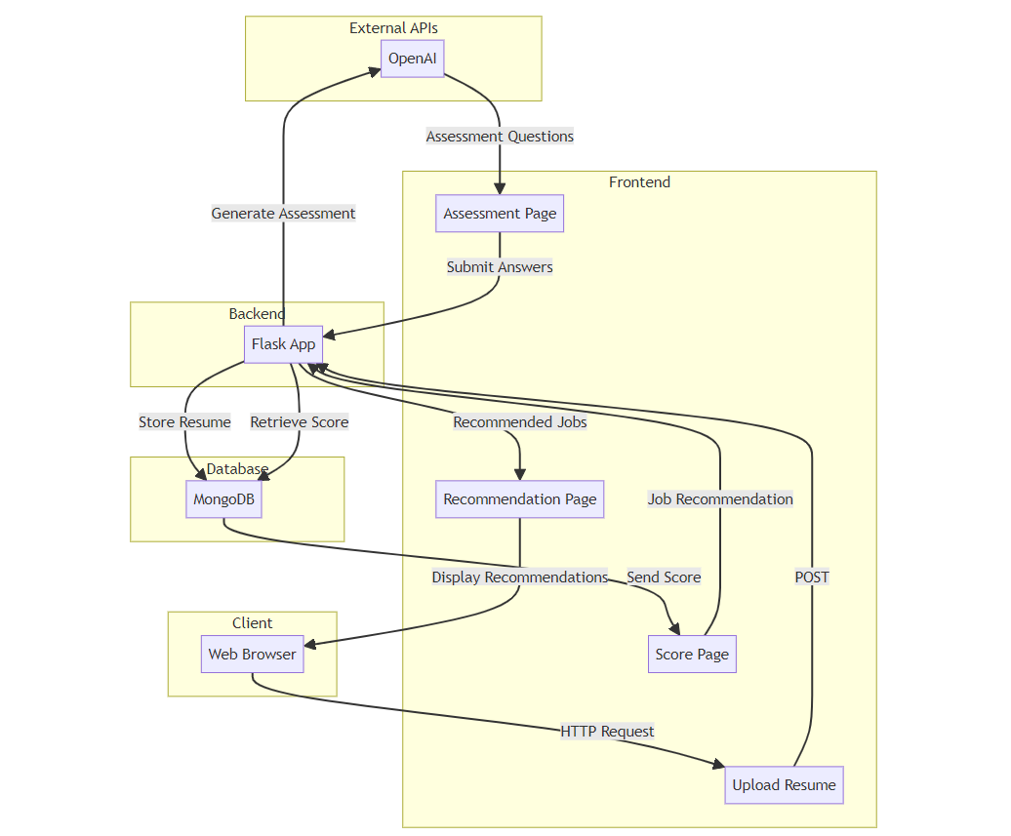
Architecture Diagram

Slide 11
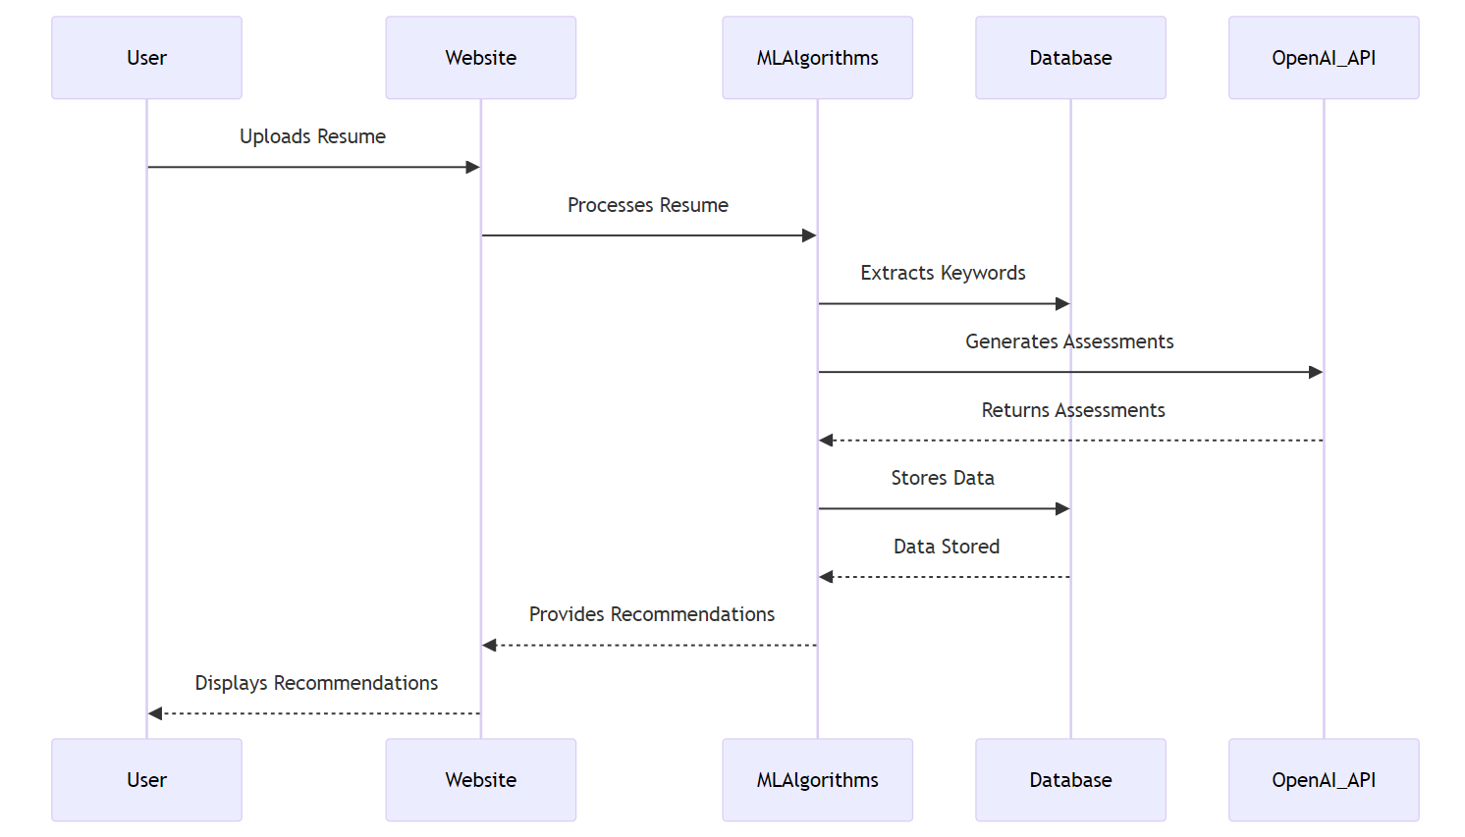
SEQUENCE DIAGRAM

Slide 12
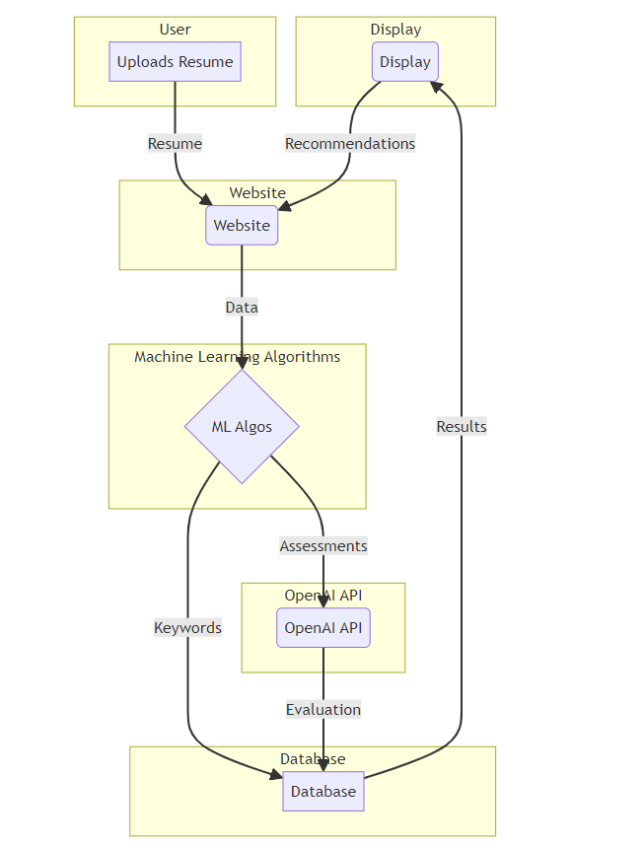
Flow Diagram

Slide 13
Functional Description
MODULES
1.Resume Upload:
The resume upload module facilitates the seamless uploading of resumes by users. It utilizes Flask APIs to handle file uploads, ensuring efficient transmission of resume data to the backend server. Uploaded resumes undergo preprocessing to extract textual content, which is then analyzed using natural language processing (NLP) techniques. Technologies like BeautifulSoup and NLTK are leveraged to parse and analyze resume content, extracting relevant keywords and skills for further processing.
2.Resume Analysis:
In the resume analysis module, advanced NLP algorithms are employed to extract valuable insights from user-uploaded resumes. Extracted keywords and skills are weighted based on their frequency and relevance to the user's career objectives. These weighted keywords are stored in a MongoDB database for subsequent analysis and recommendation generation. The backend utilizes Flask APIs to handle resume processing and database interactions, ensuring efficient and scalable analysis of resume data.

Slide 14
Functional Description
3.Skill Assessment:
The skill assessment module enables users to assess their proficiency levels in various domains relevant to their career aspirations. Leveraging insights from resume analysis, the backend dynamically generates personalized assessment questions tailored to the user's skills and experiences. Flask APIs handle assessment requests and process user responses, calculating proficiency scores based on predefined criteria. Adaptive algorithms adjust assessment difficulty levels based on user performance, providing a customized evaluation experience.
4. Proficiency Evaluation:
The proficiency evaluation module evaluates user responses from skill assessments to determine proficiency levels in different domains. User scores and assessment results are stored in the MongoDB database for future reference and analysis. Advanced algorithms adapt assessment difficulty levels based on user performance, ensuring accurate proficiency evaluation.

Slide 15
Functional Description
5.Job Recommendation:
The job recommendation module utilizes machine learning algorithms to provide personalized job recommendations aligned with users' skills and career objectives. Analyzing user profiles and resume data, the backend identifies relevant job opportunities from a vast database of job listings. Recommendation algorithms such as content-based filtering is used to consider user preferences, historical job interactions, and industry trends to generate tailored job suggestions. These recommendations are presented to users through the frontend interface, enabling them to explore detailed job descriptions and apply for positions directly.
6. Job Matching:
The job matching module evaluates user qualifications against job requirements to ensure optimal alignment between users and job opportunities. Leveraging recommendation algorithms and user profile data, the backend assesses the suitability of job listings for individual users. Job matching algorithms consider factors such as skills, experience, location, and industry preferences to identify the most relevant job matches. Seamless integration with frontend components and backend services enables users to make informed decisions about their career paths, enhancing user engagement and satisfaction.

Slide 16
Sample coding
urcareerapp.py
from flask import Flask, redirect, render_template, request, jsonify, url_for
from flask_pymongo import PyMongo
import openai
import nltk
from nltk.corpus import stopwords
from nltk.tokenize import word_tokenize
import fitz
from docx import Document # python-docx for DOCX files
import os
app = Flask(__name__, template_folder='templates', static_folder='static')
app.config["MONGO_URI"] = "mongodb://localhost:27017/urcareer"
app.config['UPLOAD_FOLDER'] = 'uploads' # Folder to store uploaded files
mongo = PyMongo(app)
collection = mongo.db.resume
nltk.download('punkt')
nltk.download('stopwords')

Slide 17
Sample coding
urcareerapp.ipynb
def get_collaborative_recommendations(user_id, user_similarity, top_n=3):
similar_users = list(enumerate(user_similarity[user_id]))
similar_users = sorted(similar_users, key=lambda x: x[1], reverse=True)[1:top_n+1]
recommended_jobs = set()
for user, score in similar_users:
user_jobs = set(interaction_df[interaction_df['Resume_ID'] == user]['Job_ID'])
recommended_jobs = recommended_jobs.union(user_jobs)
return recommended_jobs
def get_content_based_recommendations(resume_id, cosine_similarities, top_n=3):
sim_scores = list(enumerate(cosine_similarities[resume_id]))
sim_scores = sorted(sim_scores, key=lambda x: x[1], reverse=True)[:top_n]
recommended_jobs = [job[0] for job in sim_scores]
return recommended_jobs
content_recommendations = get_content_based_recommendations(0, cosine_similarities)
print("Content-Based Filtering Recommendations for Resume 0:", content_recommendations)

Slide 18
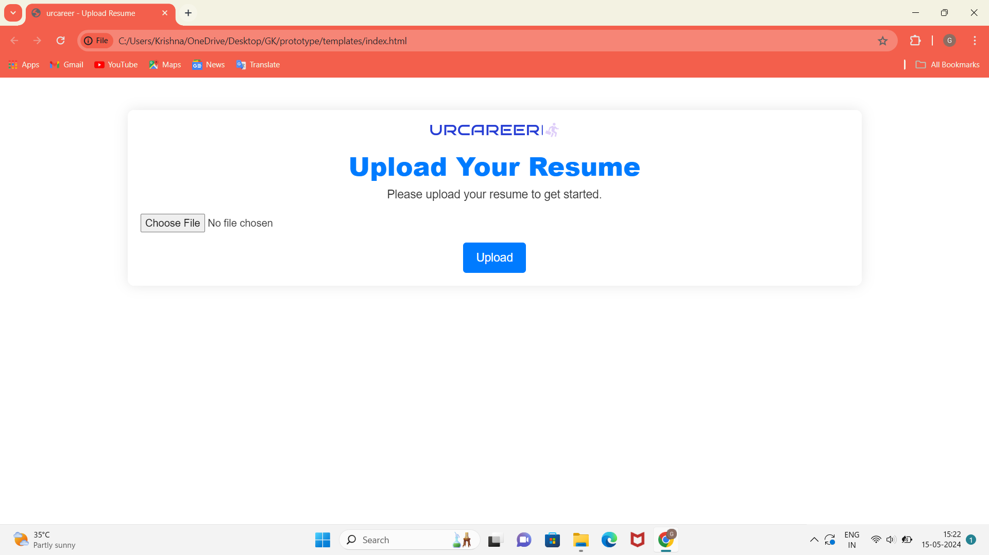
Outputs and Final Results
urcareer Front-end:Uploading resume in the urcareer site

Slide 19
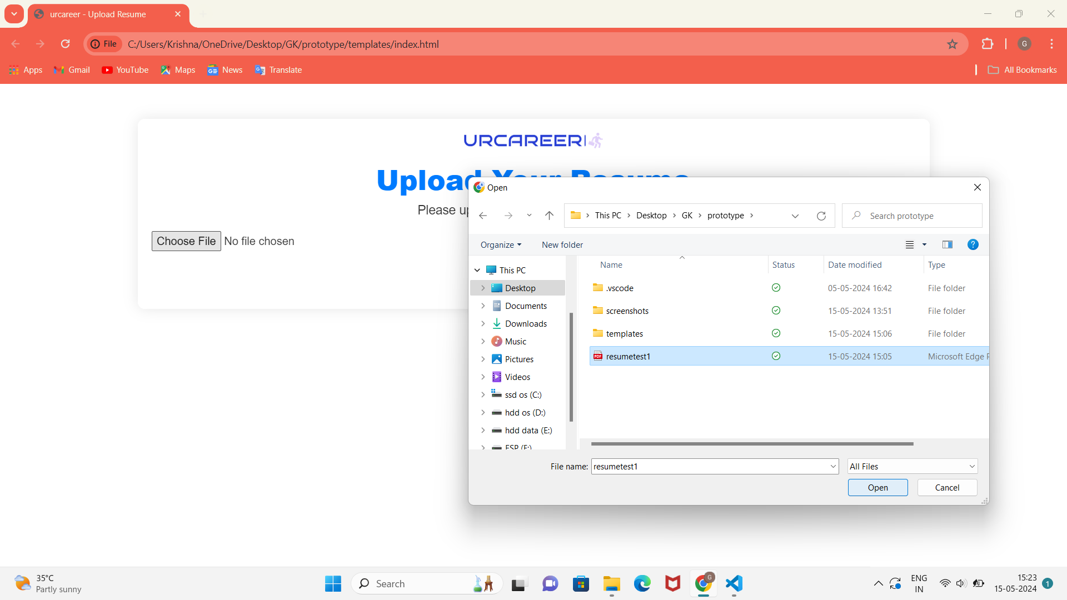
Outputs and Final Results
urcareer Front-end:Uploading resume in the urcareer site

Slide 20
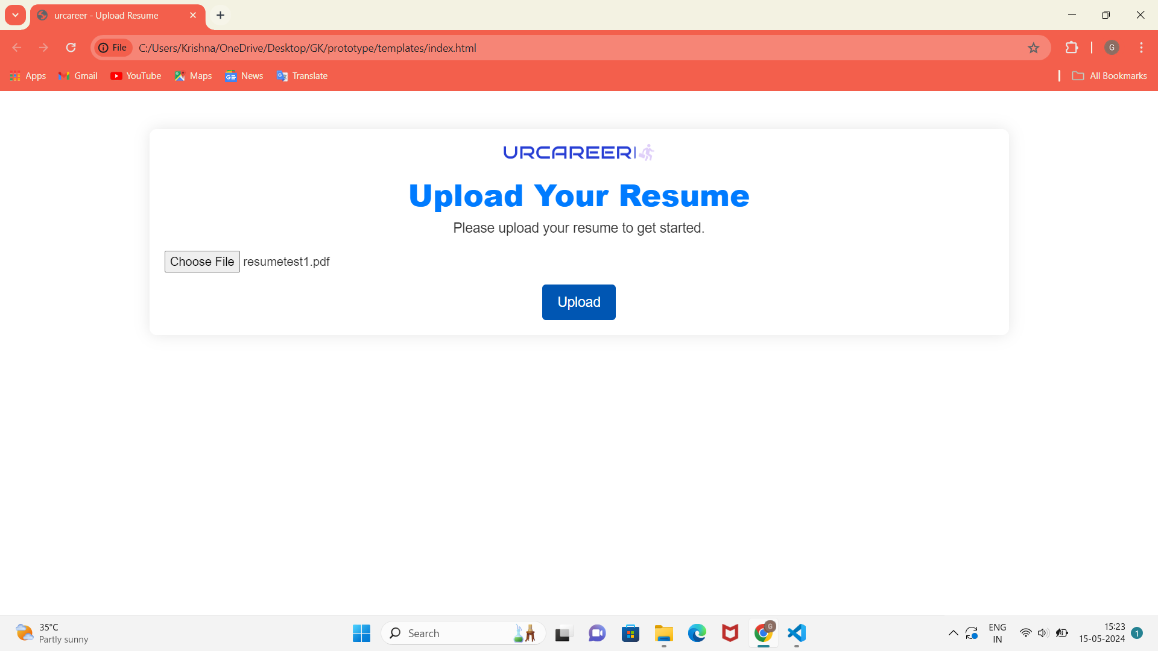
Outputs and Final Results
urcareer Front-end:Uploading resume in the urcareer site

Slide 21
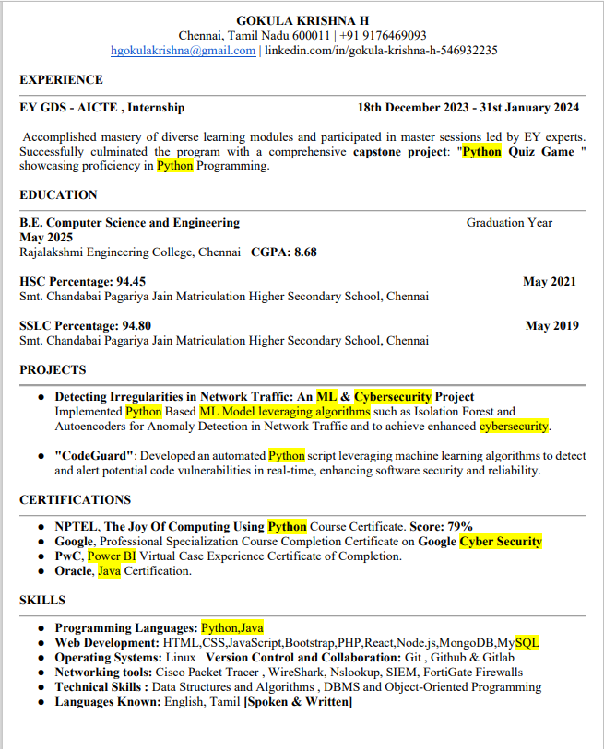
Outputs and Final Results
Sample Resume:

Slide 22
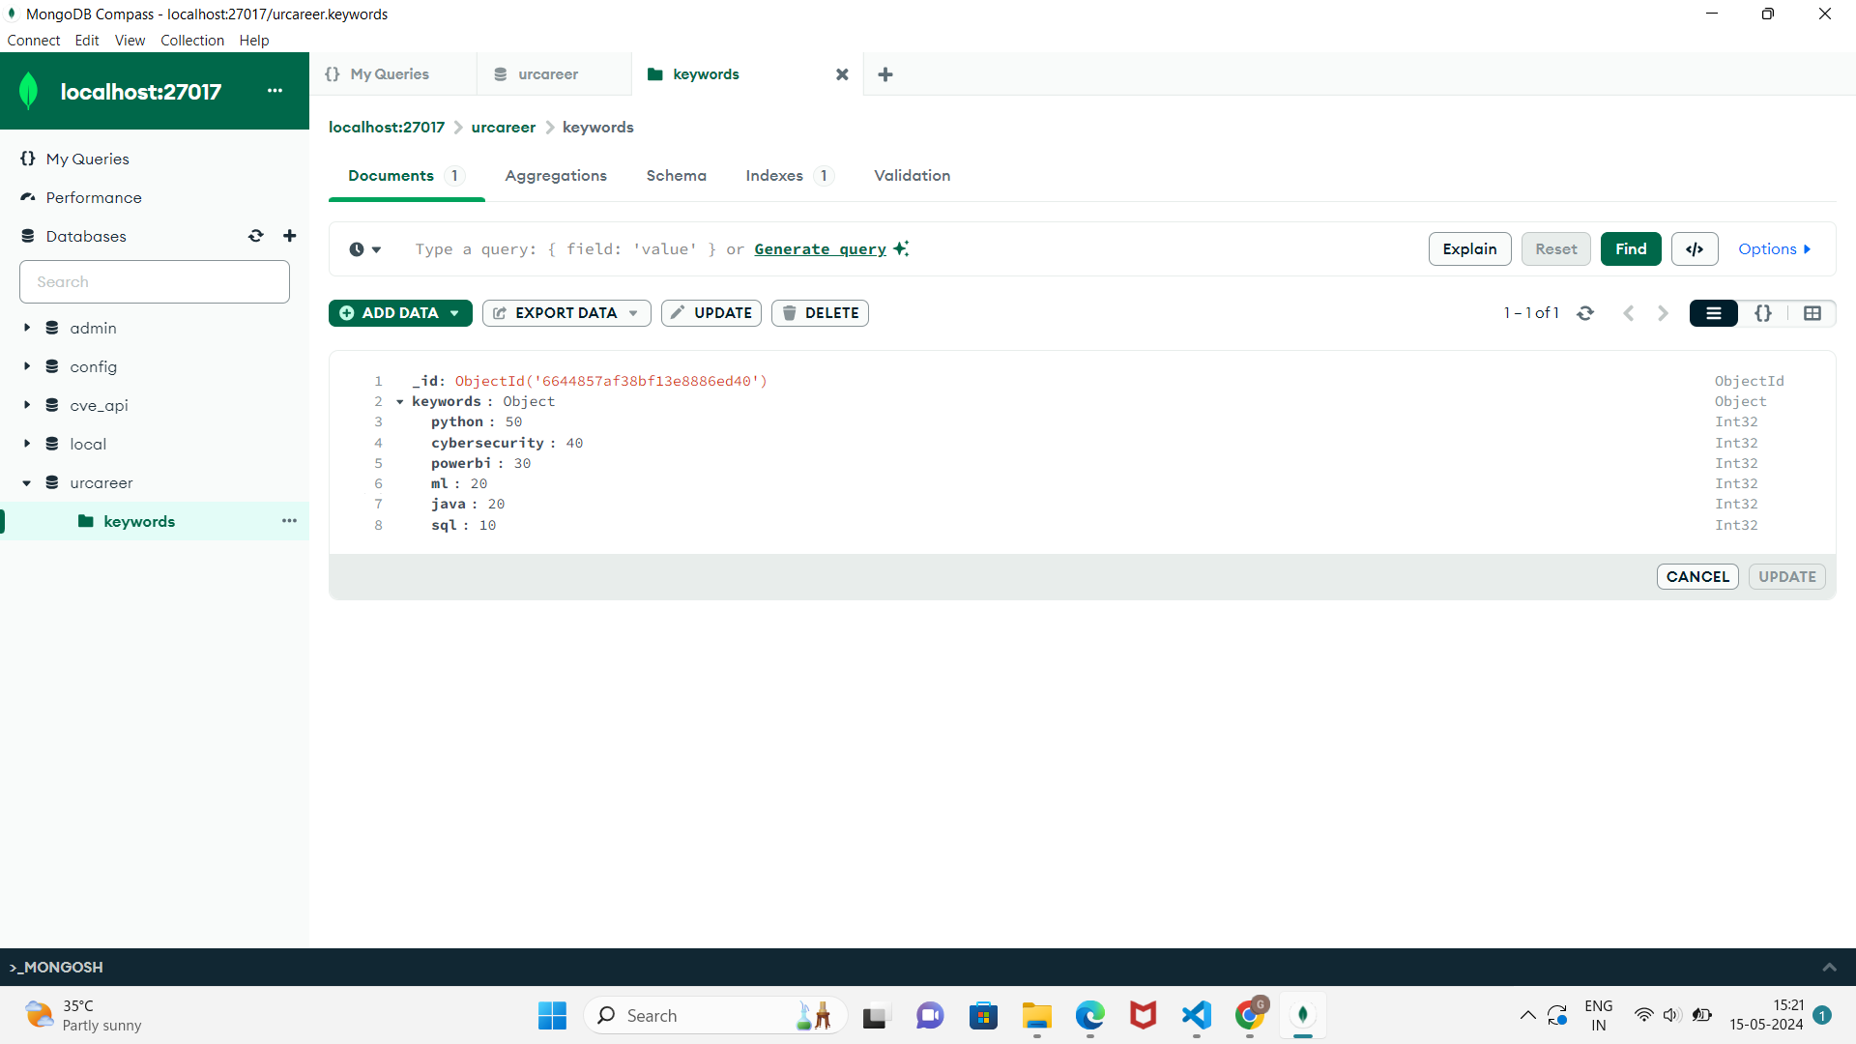
Outputs and Final Results
urcareer Back-end: After Uploading Keywords Extracted and stored in MongoDB as a Collection.

Slide 23
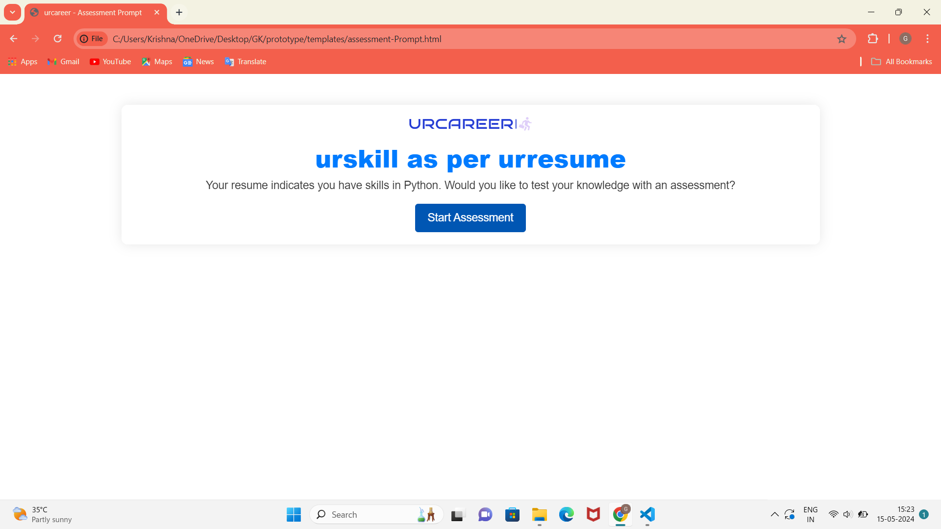
Outputs and Final Results
urcareer Front-end: High-weightage Skill Assessment Generation

Slide 24
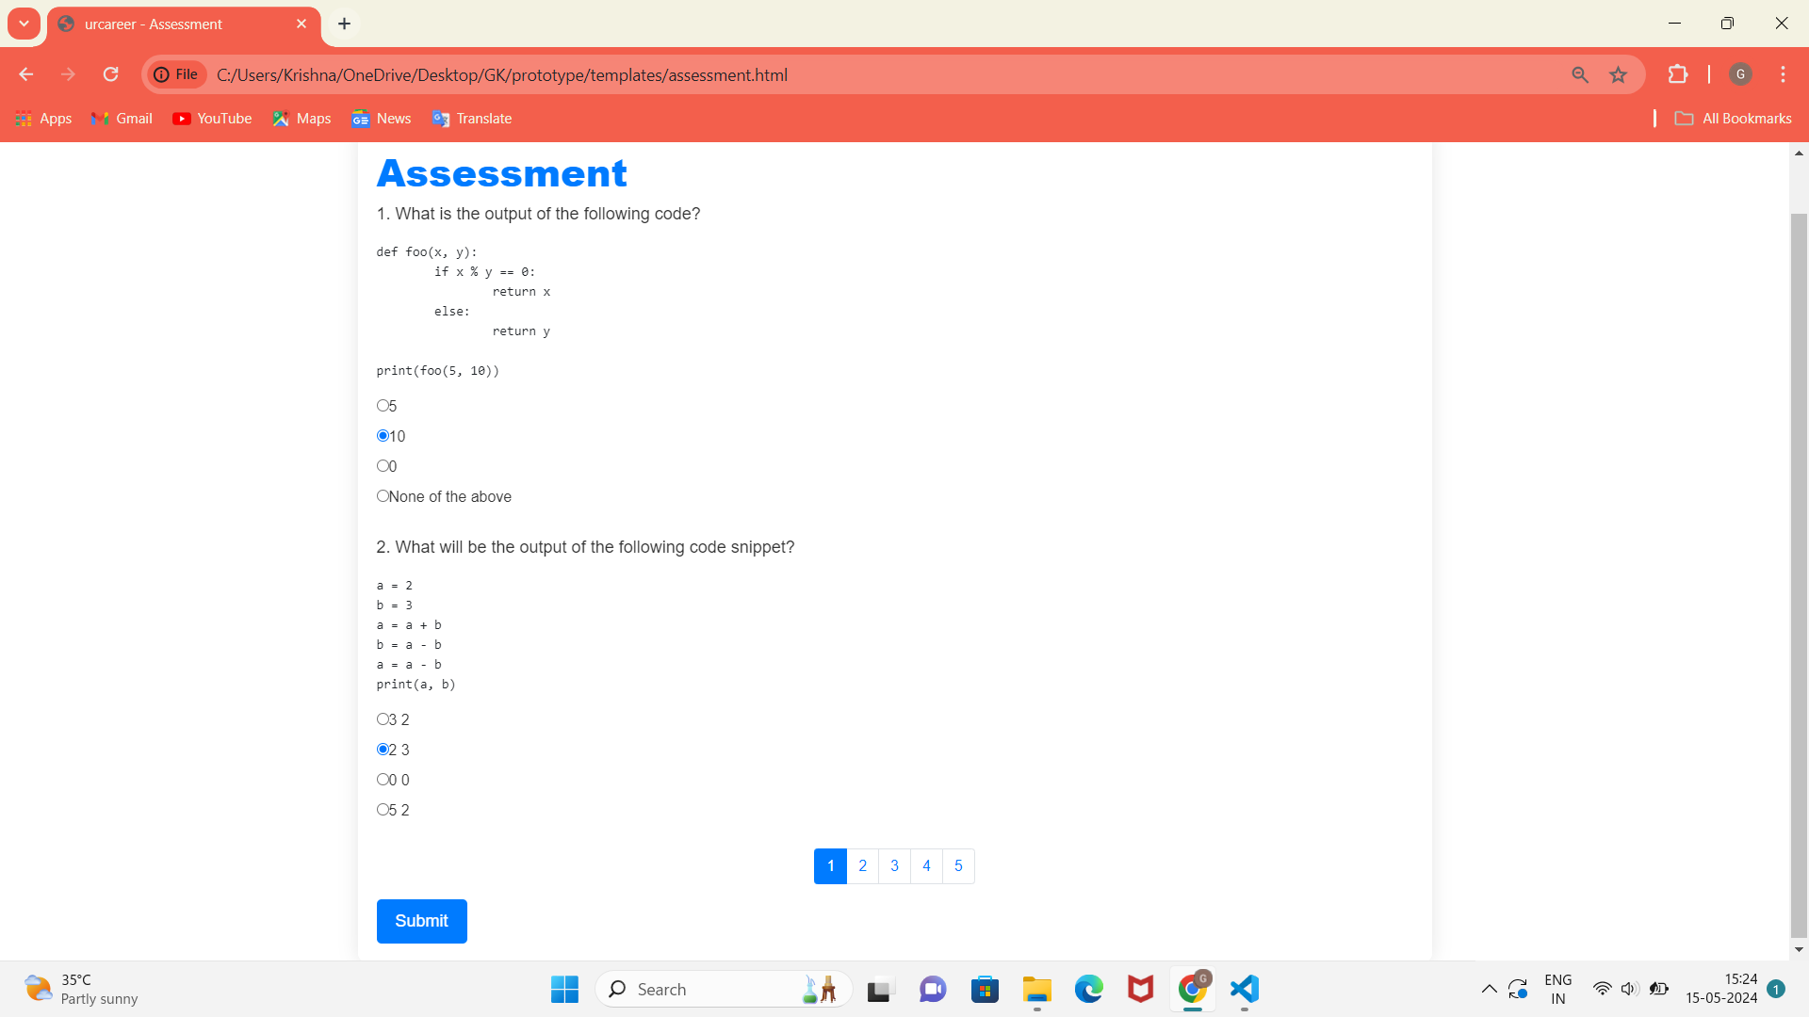
Outputs and Final Results
urcareer Front-end: ASSESSMENT PAGE

Slide 25
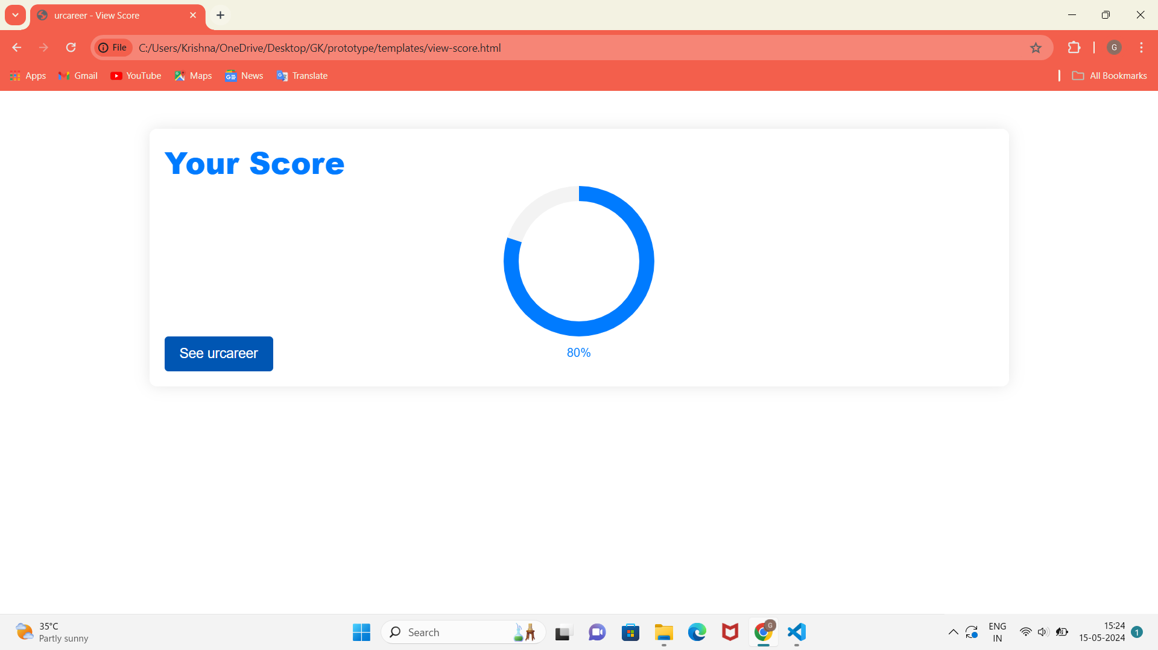
Outputs and Final Results
urcareer Front-end: Evaluation of Scores ( above 70% only recommend jobs)

Slide 26
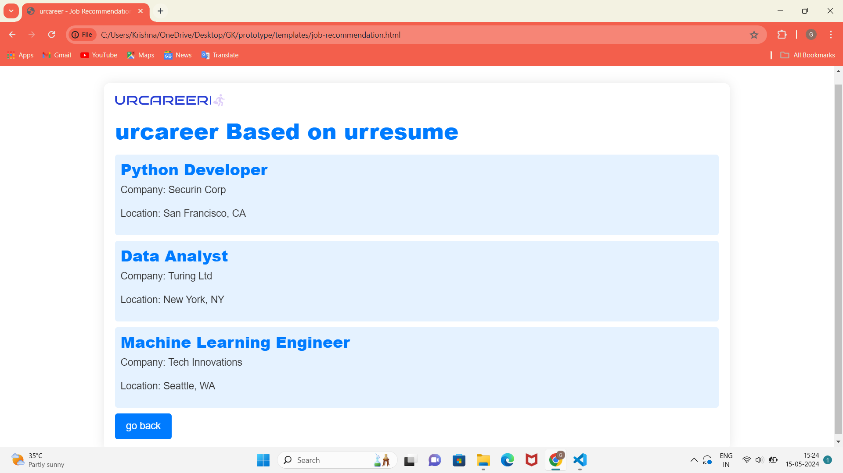
Outputs and Final Results
urcareer Front-end: Personalized Job Recommendation

Slide 27
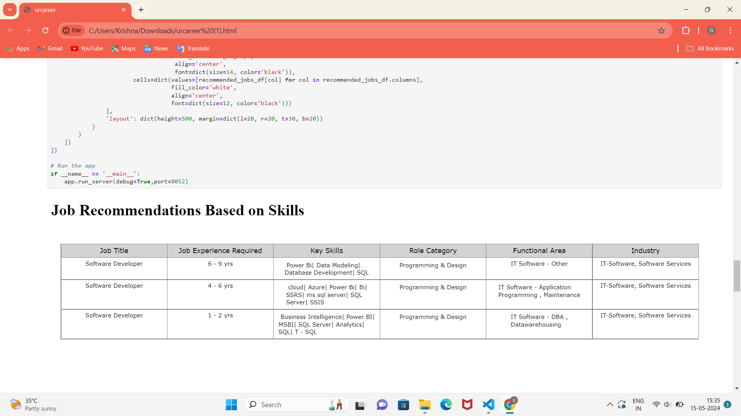
Outputs and Final Results
urcareer Jupiter Notebook: Content-based Filtering

Slide 28
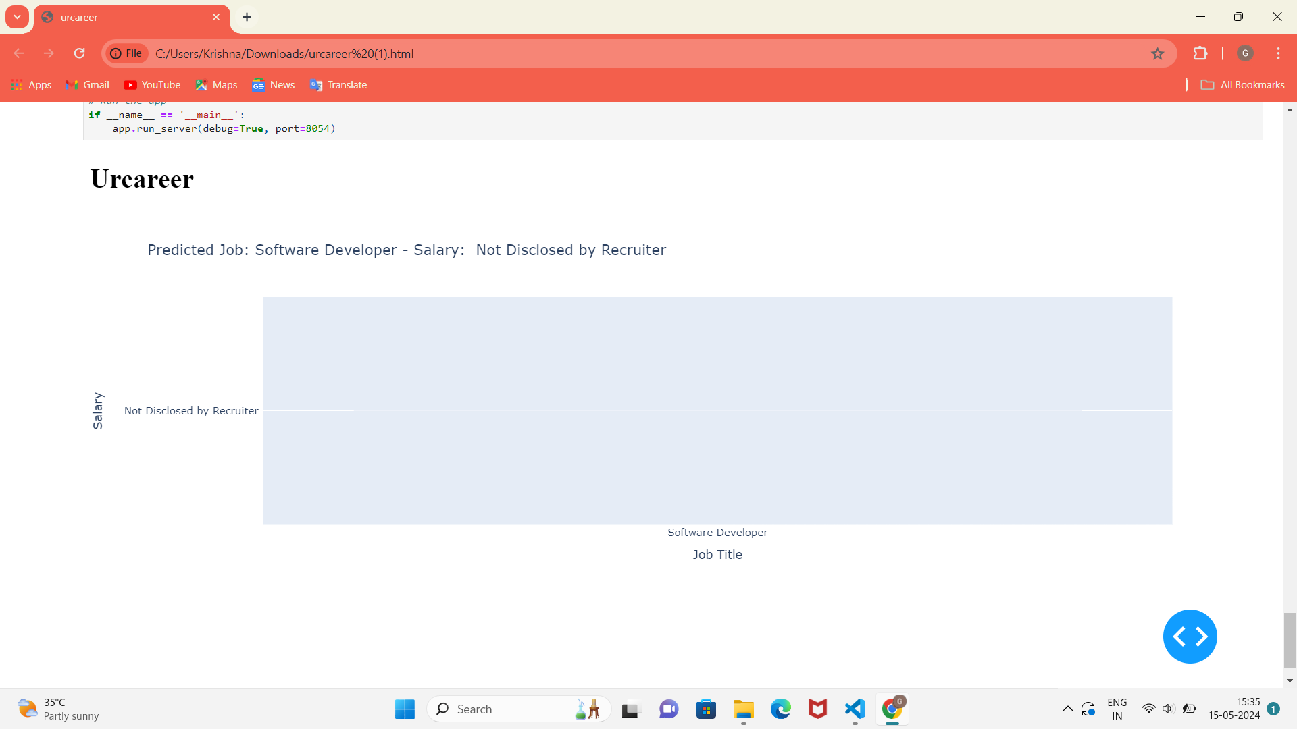
Outputs and Final Results
urcareer Jupiter Notebook: Content-based Filtering

Slide 29
Conclusion and Future Enhancements
In conclusion, the career guidance application leverages advanced technologies and robust backend architecture to provide users with personalized career insights, skill assessments, and job recommendations. Through modules such as user authentication, resume analysis, and job matching, the application empowers users to make informed decisions about their career paths. By integrating natural language processing (NLP), machine learning algorithms, and database management systems, the application delivers a seamless and intuitive user experience.
Future Enhancements:
1.Integration with Online Learning Platforms
2.Gamification Features

Slide 30
References
Harvey & Paul Deitel & Associates, Harvey Deitel and Abbey Deitel, “Internet and World Wide Web - How To Program”, Fifth Edition, Pearson Education, 2011.
Jeffrey C and Jackson, “Web Technologies A Computer Science Perspective”, Pearson Education, 2011.
S. Russell and P. Norvig, Artificial Intelligence: A Modern Approach, Prentice Hall, Third Edition, 2015.
Nils J. Nilsson, Artificial Intelligence: A New Synthesis (1 ed.), Morgan-Kaufmann, 1998. ISBN 978- 1558605350.
Stephen Marsland, “Machine Learning – An Algorithmic Perspective”, Second Edition, Chapman and Hall/CRC Machine Learning and Pattern Recognition Series, 2014.

Slide 31
Thank You

